Slide 1


Slide 2

Introduction

Slide 3
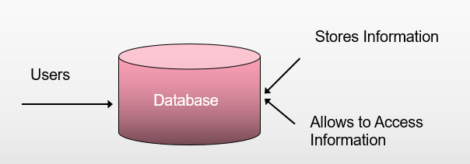
Data
Data is facts and statistics stored or free flowing over a network, generally it's raw and unprocessed.
Or
Data means information and it is the most important component in any work that is done.
Data-Base:
A Database is a collection of related data organized in a way that data can be easily accessed, managed, and updated

Slide 4

Data Management
Data management deals with managing large amount of information, which involves both the storage of information and the provision of mechanisms for the manipulation of information.
The two different approaches of managing data are:
File-based systems
Database systems

Slide 5


File Based Systems
An early attempt to computerize the manual filing system .
A collection of records or documents dealing with one organization, person, area or subject.
Manual (paper) files.
Computer files.

Slide 6
Problems with file storage
The process of manually maintaining data through files is :
Tedious
Time consuming
Error prone.
Disadvantages of File-based Systems are:
Data Redundancy and Inconsistency
Unanticipated Queries
Data Isolation
Concurrent Access Anomalies
Security Problems
Integrity Problems

Slide 7
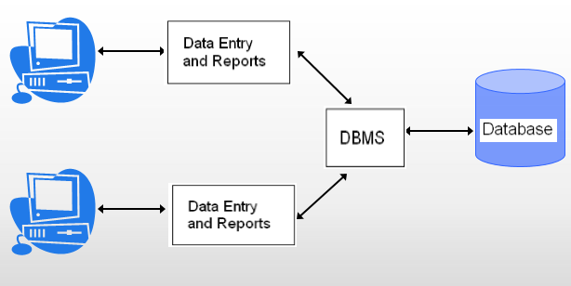
Database Systems
A DBMS is a software that allows creation, definition and manipulation of database, allowing users to store, process and analyze data easily.
Here are some examples of popular DBMS used these days:
MySql
Oracle
SQL Server
IBM DB2
PostgreSQL
Amazon SimpleDB (cloud based) etc.
// We will be studying SQL SERVER

Slide 8
Advantages of database systems:
The amount of redundancy in the stored data can be reduced.
No more inconsistent data.
The stored data can be shared.
Standard can be set and followed.
Data integrity can be maintained.
Security of data can be implemented.
Solved issues of handling large volume of data.
Used to store data in an efficient and organize manner.
Allows quick and easy management of data.
Data is more permanent and long-lasting.
Disadvantages of DBMS
It's Complexity
Except MySQL, which is open source, licensed DBMSs are generally costly.
They are large in size

Slide 9
DBMS Models
A Database model defines the logical design and structure of a database and defines how data will be stored, accessed and updated in a database management system.
Or
you can say Databases can be differentiated based on functions and model of the data. A data model describes a container for storing data, and the process of storing and retrieving data from that container.
Models of Data-Base:
Flat File Data Model
Hierarchical Model
Network Model
Entity-relationship Model
Relational Model

Slide 10

Flat File Data Model
In this model, the database consists of only one table or file. This model is used for simple databases - for example, to store the roll numbers, names, subjects, and marks of a group of students. This model cannot handle very complex data. It can cause redundancy when data is repeated more than once

Slide 11
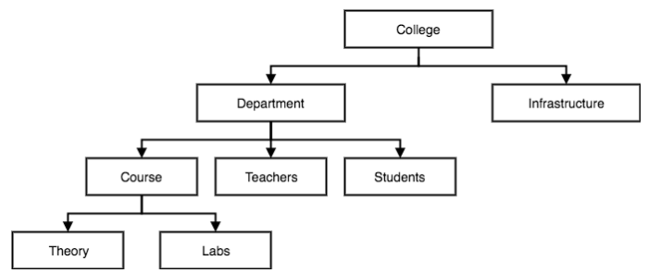
Hierarchical Model
This database model Organizes data into a tree-like-structure,
with a single root, to which all the other data is linked.
The hierarchy starts from the Root data, and expands like a tree, adding child nodes to the parent nodes.
each parent can have many children but each child only has one parent.
This model efficiently describes many real-world relationships like index of a book, recipes etc.
In hierarchical model, data is organized into tree-like structure with
one one-to-many relationship between two different types of data.
for example: one department can have many courses, many professors and of-course many students.

Slide 12
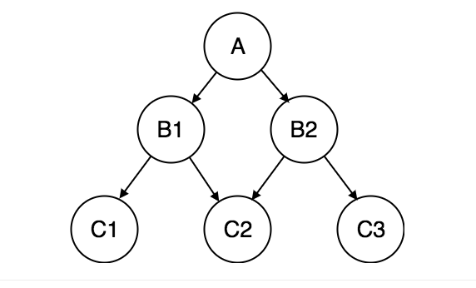
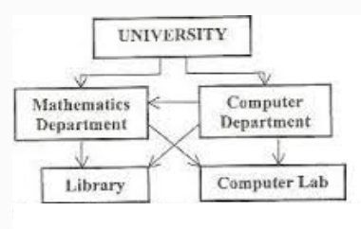
Network Model
This is an extension of the Hierarchical model. In this model data is organized more like a graph, and are allowed to have more than one parent node.
In this database model data is more related as more relationships are established in this database model.
Also, as the data is more related, hence accessing the data is also easier and fast.
This database model was used to map many-to-many data relationships.
This was the most widely used database model, before Relational Model was introduced.
The network model is a database model conceived as a easy and efficient way of representing objects and their relationships.

Slide 13
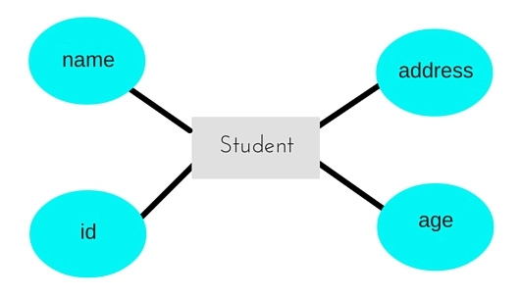
Entity-relationship Model
In this database model, relationships are created by dividing object of interest into entity and its characteristics into attributes.
Different entities are related using relationships.
E-R Models are defined to represent the relationships into pictorial form to make it easier for different stakeholders to understand.
Example: If we have to design a School Database then,
Student will be an entity with attributes name, age, address etc.
As Address is generally complex, it can be another entity with attributes street name, pincode, city etc, and there will be a relationship between them.
Relationships can also be of different types.
//It will be discussed in details later.

Slide 14
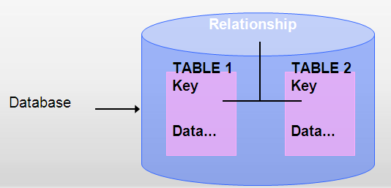
Relational Model
A Relational Database Management System (RDBMS) is a database management system where all data visible to the user is organized strictly as tables of data values, and where all database operations take place on these tables.
A relational database is a database divided into logical units called tables, where tables are related to one another within the database.
This model was introduced by E.F Codd in 1970, and since then it has been the most widely used database model, infact, we can say the only database model used around the world.

Slide 15
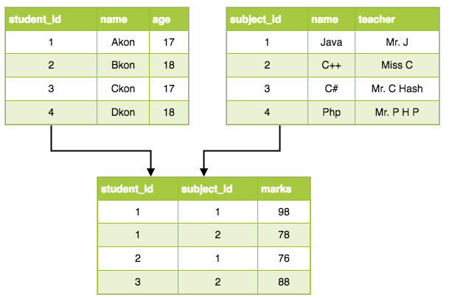
In this model, data is organized in two-dimensional tables and the relationship is maintained by storing a common field.
The basic structure of data in the relational model is tables.
All the information related to a particular type is stored in rows of that table.
In the relational model, there is no physical link.
All data is maintained in the form of tables consisting of rows and columns.
Data in two tables is related through common columns.

Slide 16
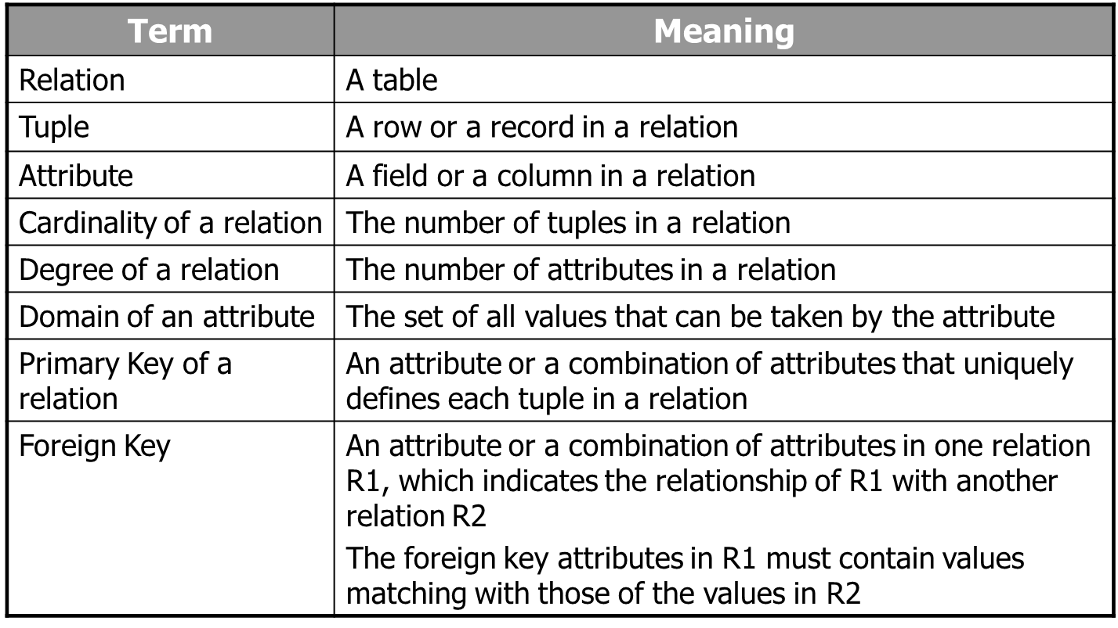
Terms mostly used in RDBMS:

Slide 17
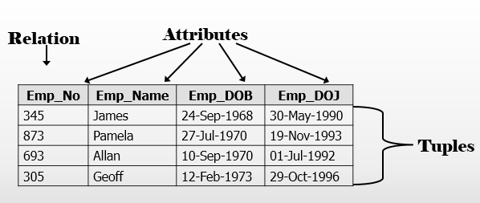
Entities and Tables
An entity is a person, place, thing, object, event, or even a concept, which can be distinctly identified.
Each entity has certain characteristics known as attributes.
A table contains a group of related entities called an entity set.
The terms entity set and table are often used interchangeably. A table is also called a relation, rows are known as tuples and columns are known as attributes.

Slide 18
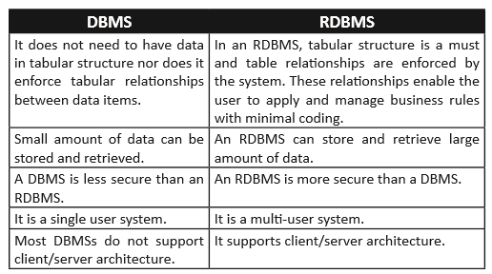
Difference Between
DBMS & RDBMS

Slide 19
Data Modeling:
The process of applying an appropriate data model to the data, in order to organize and structure it, is called data modeling.
The Entity-Relationship, Relational, Network, and Hierarchical models are examples of data models.
The development of every database begins with the basic step of analyzing its data in order to determine the data model that would best represent it. Once this step is completed, the data model is applied to the data.
The analysis of data objects and their relationships to other data objects.
Data modeling is often the first step in creating a database
Data modeling is as essential to database development as are planning and designing to any project development. Building a database without a data model is similar to developing a project without its plans and design.

Slide 20
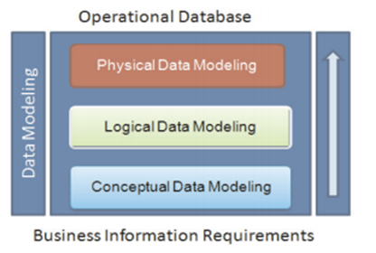
Data models help database developers to define the relational tables, primary and foreign keys, stored procedures, and triggers required in the database.
Data modeling can be broken down into the following three broad steps: Conceptual Data Modeling
The data modeler identifies the highest level of relationships in the data.
Logical Data Modeling
The data modeler describes the data and its relationships in detail. The data modeler creates a logical model of the database.
Physical Data Modeling
The data modeler specifies how the logical model is to be realized physically.

Slide 21
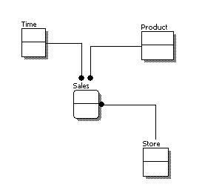
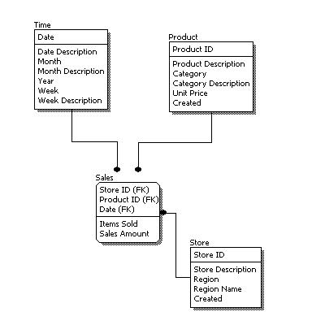
Conceptual Data Model
A conceptual data model identifies the highest-level relationships between the different entities.
No attribute is specified.
No primary key is specified
Logical Data Model
A logical data model describes the data in as much detail as possible, without regard to how they will be physical implemented in the database.
Identify entity and relationships.
All attributes of each entity.
Identify primary and foreign key.

Slide 22
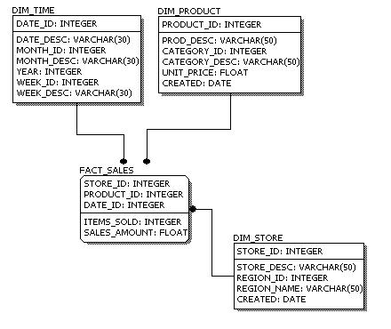
Physical Data Model
Physical data model represents how the model will be built in the database.
Comparison:
Feature | Conceptual | Logical | Physical
Entity Names | ✓ | ✓
Entity Relationships | ✓ | ✓
Attributes |  | ✓
Primary Keys |  | ✓ | ✓
Foreign Keys |  | ✓ | ✓
Table Names |  |  | ✓
Column Names |  |  | ✓
Column Data Types |  |  | ✓

Slide 23
Database Keys
Keys are used to establish and identify relationships between tables and also to uniquely identify any record or row of data inside a table.
A Key can be a single attribute
Or
a group of attributes, where the combination may act as a key.
Need Of Keys
Number of tables required for storing, different tables are related to each other, tables store a lot of data in them.
To fetch any particular record from database, one has to apply some conditions, but if duplicate data is present ?
To avoid all this, Keys are defined to easily identify any row of data in a table.
Let's try to understand about all the keys using a simple example.
student_id | name | phone | age
1 | Akon | 9876723452 | 17
2 | Akon | 9991165674 | 19
3 | Bkon | 7898756543 | 18
4 | Ckon | 8987867898 | 19
5 | Dkon | 9990080080 | 17

Slide 24
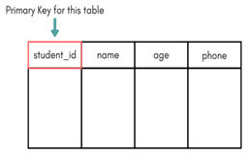
Primary Key
Primary key is a //candidate key that is most appropriate to become the main key for any table. It is a key that can uniquely identify each record in a table.
Super Key
set of attributes within a table that can uniquely identify each record within a table.
//Super Key is a superset of Candidate key.
In the table above super key would include student_id, (student_id, name), phone.
As student_id is unique for every row of data, hence it can be used to identity each row uniquely.
(student_id, name), now name of two students can be same, but their student_id can't be same hence this combination can also be a key.
phone number for every student will be unique, hence again, phone can also be a key.
So they all are super keys

Slide 25
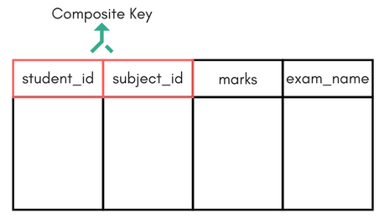
Candidate Key
Candidate keys are defined as the minimal set of fields which can uniquely identify each record in a table.
In our example, student_id and phone both are candidate keys for table Student.
•A candiate key can never be NULL or empty. And its value should be unique.
•There can be more than one candidate keys for a table.
•A candidate key can be a combination of more than one columns(attributes).
Composite Key
Key that consists of two or more attributes that uniquely identify any record in a table is called Composite key. But the attributes which together form the Composite key are not a key independently or individually.
Here we have a Score table which stores the marks scored by a student in a particular subject.
In this table student_id and subject_id together will form the primary key, hence it is a composite key.

Slide 26
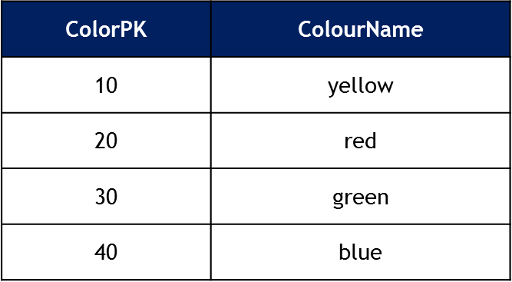
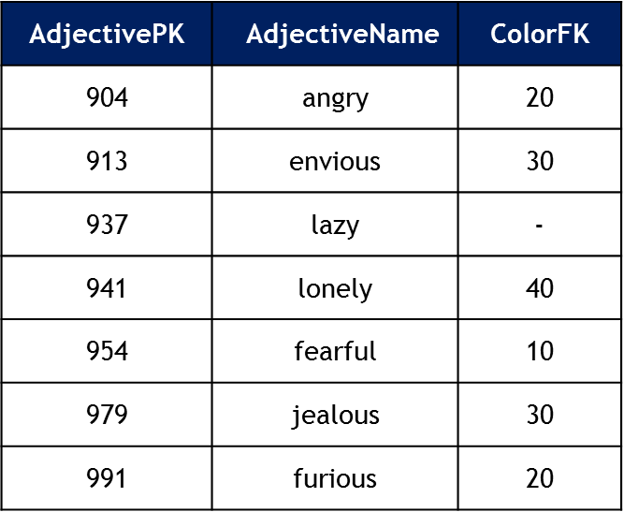
Foreign Key
A foreign key is a column, or combination of columns, that contain values that are found in the primary key of some table (including, possibly, itself).
A foreign key may be null, and almost always is not unique.
Secondary
(or Alternative key)
The candidate key which are not selected as primary key are known as secondary keys or alternative keys.
Non-key Attributes
Non-key attributes are the attributes or fields of a table, other than candidate key attributes/fields in a table.
Non-prime Attributes
Non-prime Attributes are attributes other than Primary Key attribute(s)..

Slide 27
Entity-relationship model
In software engineering, an entity-relationship model (ER Model) is an conceptual representation of data.
Entity-relationship modeling is a database modeling method, used to produce a type of conceptual schema (a representation of a plan or theory in the form of an outline or model) of a system, often a relational database.
Diagrams created by this process are called
Entity-Relationship Diagrams, ER diagrams, or ERDs.
ER Diagram is a visual representation of data that describes how data is related to each other. In ER Model, we disintegrate data into entities, attributes and setup relationships between entities, all this can be represented visually using the ER diagram.
ER-Model
Three major elements in ER-Model
Entity
Attributes
Relationships

Slide 28

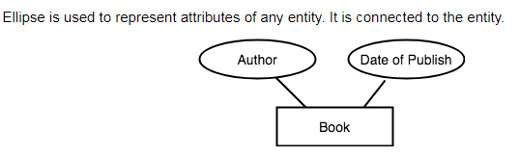
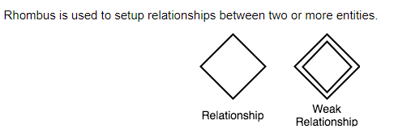
Entity:
A person, place or thing about which the data is collected.
For example: entity of “student”
Attributes:
Type of information that is captured related to the entity.
For the employee entity, some related attributes
include the
Employee ID,
Employee Name, etc.
Relationship
A relationship is an association or bond that exists between one or more entities.
For example :
Belongs to,
own,
works for,
saves in,
purchases and so on

Slide 29
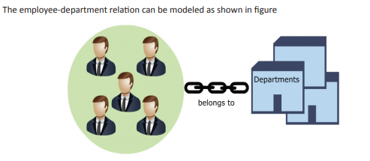
The model is based on a simple idea. Data can be perceived as real-world objects called entities and the relationships that exist between them.
For example,
the data about employees working for an organization can be perceived as a collection of employees and a collection of the various departments that form the organization. An employee belongs to a department. Thus, the relation 'belongs to' links an employee to a particular department.
Depending upon the number of entities involved, a degree is assigned to relationships.
For example:
if 2 entities are involved, it is said to be Binary relationship,
if 3 entities are involved, it is said to be Ternary relationship, and so on.

Slide 30
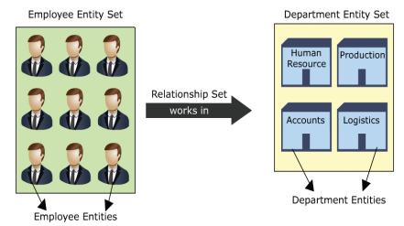
Entity Set
An entity set is the collection of similar entities. For example, the employees of an organization collectively form an entity set called employee entity set.
Relationship Set
A collection of similar relationships between two or more entity sets is called a relationship set. For example, employees work in a particular department. The set of all 'work in' relations that exists between the employees and the department is called the 'work in' relationship set

Slide 31
Relationships associate one or more entities and can be of three types.
Self-relationships:
Relationships between entities of the same entity set are called self-relationships.
For example, a manager and his team member, both belong to the employee entity set. The team member works for the manager. Thus, the relation, 'works for', exists between two different employee entities of the same employee entity set.
Binary relationships
Relationships that exist between entities of two different entity sets are called binary relationships.
For example, an employee belongs to a department. The relation exists between two different entities, which belong to two different entity sets. The employee entity belongs to an employee entity set. The department entity belongs to a department entity set.
Ternary relationships
Relationships that exist between three entities of different entity sets are called ternary relationships.
For example, an employee works in the accounts department at the regional branch. The relation, 'works' exists between all three, the employee, the department, and the location.

Slide 32
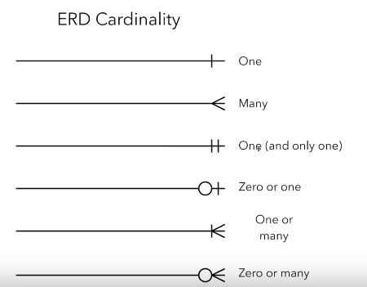
Relationships can also be classified as per mapping cardinalities.
The different mapping cardinalities, few are as follows:
One-to-One
One-to-Many
Many-to-One
Many-to-Many

Slide 33
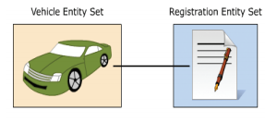

One-to-One
This kind of mapping exists when an entity of one entity set can be associated with only one entity of another set.
Consider the relationship between a vehicle and its registration. Every vehicle has a unique registration. No two vehicles can have the same registration details. The relation is one-to-one, that is, one vehicle-one registration. The mapping cardinality can be seen in figure
SYMBOLICALLY:

Slide 34
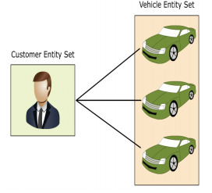

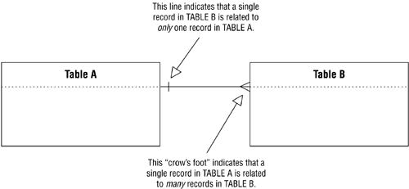
One-to-Many
This kind of mapping exists when an entity of one set can be associated with more than one entity of another entity set.
Consider the relation between a customer and the customer's vehicles. A customer can have more than one vehicle. Therefore, the mapping is a one to many mapping, that is, one customer - one or more vehicles. The mapping cardinality can be seen in figure
SYMBOLICALLY:
EXPLANATION:

Slide 35
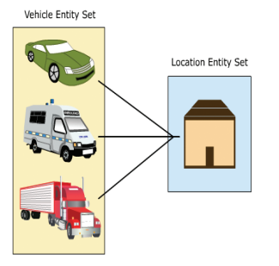
Many-to-One
This kind of mapping exists when many entities of one set is associated with an entity of another set. This association is done irrespective of whether the latter entity is already associated to other or more entities of the former entity set.
Consider the relation between a vehicle and its manufacturer. Every vehicle has only one manufacturing company or coalition associated to it under the relation, 'manufactured by', but the same company or coalition can manufacture more than one kind of vehicle.
The mapping can be seen in figure
SYMBOLICALLY:

Slide 36
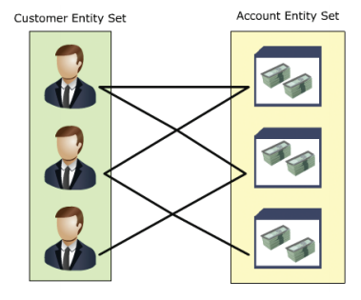

Many-to-Many
This kind of mapping exists when any number of entities of one set can be associated with any number of entities of the other entity set.
Consider the relation between a bank's customer and the customer's accounts. A customer can have more than one account and an account can have more than one customer associated with it in case it is a joint account or similar. Therefore, the mapping is many-to-many, that is, one or more customers associated with one or more accounts.
The mapping cardinality can be seen in figure
SYMBOLICALLY:

Slide 37
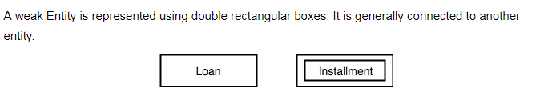
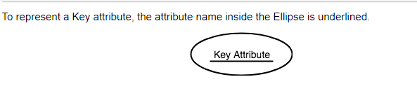

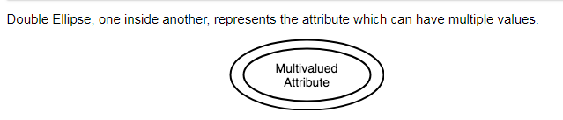

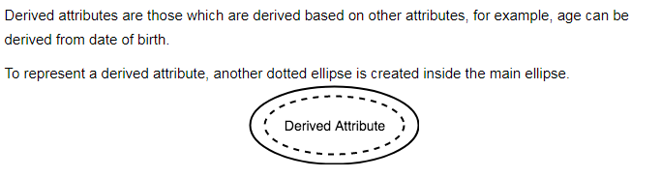

Few More Components of ERD

Slide 38
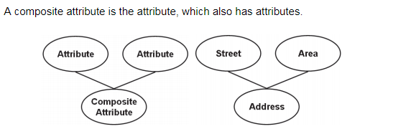
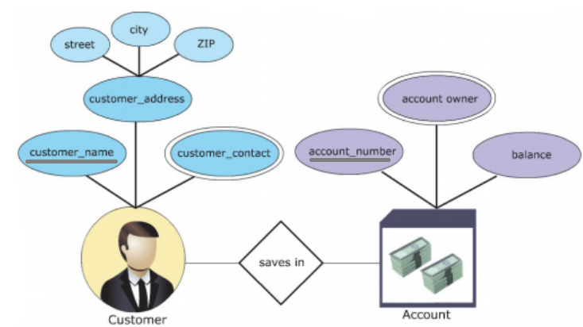
EXAMPLES

Slide 39

Normalization of Database
Technique of organizing the data in the database.
Normalization is a systematic approach of decomposing tables to eliminate data redundancy(repetition) and undesirable characteristics like
Repetition Anomaly
Insertion Anomaly
Deletion Anomaly
Updating Anomaly
//Details from book
It is a multi-step process that puts data into tabular form, removing duplicated data from the relation tables.
Normalization is used for mainly two purposes,
Eliminating redundant(useless) data.
Ensuring data dependencies make sense i.e data is logically stored

Slide 40

Problems Without Normalization
If a table is not properly normalized and have data redundancy then it will not only eat up extra memory space but will also make it difficult to handle and update the database, without facing data loss. Insertion, Updation and Deletion Anomalies are very frequent if database is not normalized.
Normalization Rule
Normalization rules are divided into the following normal forms:
First Normal Form-1NF
Second Normal Form-2NF
Third Normal Form-3NF
Initially, Codd (1972) presented three normal forms (1NF, 2NF, and 3NF),
The fourth and fifth normal forms are
based on multi-value and join
dependencies and
were proposed later.

Slide 41
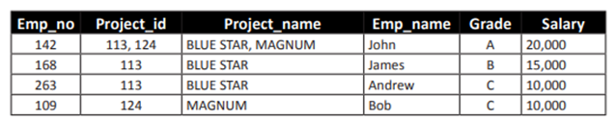

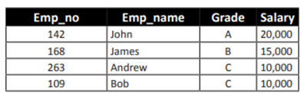
First Normal Form
In order to achieve the first normal form, following steps need to be performed:
Create separate tables for each group of related data
The table columns must have atomic values
All the key attributes must be identified
Consider the Employee Project Details table shown in table
The table has data related to projects and employees. The table needs to be split into two tables, that is, a Project Details table and an Employee Details table.
The table columns, Project_id and Project_names, have multiple values. The data needs to be split over different rows. The resultant tables are Project
The Emp_no attribute is the primary key for the Employee Details table. Therefore, in first normal form, the initial Employee Project Details table has been reduced to the Project Details and Employee Details tables.
//The Project_id attribute is the primary key for the Project Details table.
Notes:
Each attribute must be atomic
No repeating columns within a row.
No multi-valued columns.
1NF simplifies attributes
Queries become easier.

Slide 42

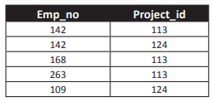
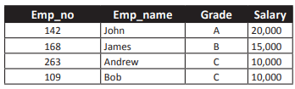
Second Normal Form
The tables are said to be in second normal form if:
They meet the requirements of the first normal form
There are no partial dependencies in the tables
The tables are related through foreign keys
Partial dependency means a non-key attribute should not be partially dependent on more than one key attribute. The Project Details and Employee Details tables do not exhibit any partial dependencies.
The Project_name is dependent only on Project_id and
Emp_name, Grade, and Salary are dependent only on Emp_no.
The tables also need to be related through foreign keys.
A third table, named Employee Project Details, is created with only two columns, Project_id and Emp_no. So, the project and employee details tables on conversion to second normal form generates tables Project Details, Employee Details, and Employee Project Details
//The attributes, Emp_no and Project_id, of the Employee Project Details table combine together to form the primary key. Such primary keys are called composite primary keys.
Notes:
Each attribute must be functionally dependent on the primary key.
Partial Functional dependency – a non-key attribute should not be partially(functionally) dependent on more than one key attribute.
Any non-dependent attributes are moved into a smaller (subset) table.
2NF improves data integrity.
Prevents update, insert, and delete anomalies.

Slide 43
Third Normal Form
To achieve the third normal form:
The tables should meet the requirements of the second normal form
The tables should not have transitive dependencies in them
The Project Details, Employee Details, and Employee Project Details tables are in second normal form.
If an attribute can be determined by another non-key attribute, it is called a transitive dependency.
To make it simpler, every non-key attribute should be determined by the key attribute only.
If a non-key attribute can be determined by another non-key attribute, it needs to put into another table. On observing the different tables, it is seen that the ProjectDetails and EmployeeProjectDetails tables do not exhibit any such transitive dependencies.
The non-key attributes are totally determined by the key attributes.
Notes:
Remove transitive dependencies.
Transitive dependency – if an attribute can be determined by another non-key attribute.
Any transitive dependencies are moved into a smaller (subset) table.
3NF further improves data integrity.
Prevents update, insert, and delete anomalies.

Slide 44
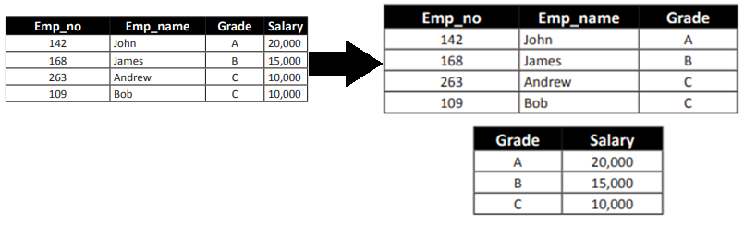
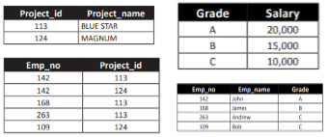
In our example Project_name is only determined by Project_number. On further scrutinizing the Employee Details table, a certain inconsistency is seen. The attribute Salary is determined by the attribute Grade and not the key attribute Emp_no. Thus, this transitive dependency needs to be removed. The Employee Details table can be split into the Employee Details and Grade Salary Details tables
At The End
Thus, at the end of the three normalization stages, the initial Employee Project Details table has been reduced to the
Project Details
Employee Project Details
Employee Details
Grade Salary Details

Slide 45
De-Normalization
By normalizing a database, redundancy is reduced. This, in turn, reduces the storage requirements for the database and ensures data integrity. However, it has some drawbacks. They are as follows:
Complex join queries may have to be written often to combine the data in multiple tables.
Joins may practically involve more than three tables depending on the need for information
If such joins are used very often, the performance of the database will become very poor. The CPU time required to solve such queries will be very large too. In such cases, storing a few fields redundantly can be ignored to increase the performance of the database. The databases that possess such minor redundancies in order to increase performance are called denormalized databases and the process of doing so is called denormalization

Slide 46
SQL
Structured Query Language

Slide 47
SQL
Structure Query Language(SQL) is a database query language used for storing and managing data in Relational DBMS (RDBMS).
SQL was the first commercial language introduced for E.F Codd's Relational model of database.
Today almost all RDBMS(MySql, Oracle, Infomix, Sybase, MS Access) use SQL as the standard database query language.
SQL is used to perform all types of data operations in RDBMS. //Read theory from book. Ch:3
Key Points
The basic structure in SQL is the statement.
Semicolons separate multiple SQL statements.
SQL is not case sensitive
Tools/Software's to write SQL
SQL SERVER MANAGEMENT STUDIO (SSMS)
SQL DEVELOPER, SQL WORKBENCH etc.

Slide 48
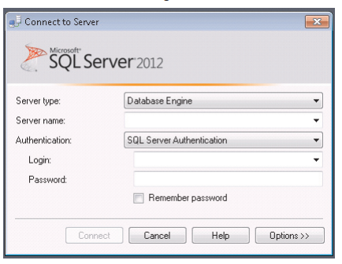
SQL SERVER MANAGEMENT STUDIO (SSMS) Interface:
As soon as SSMS will start you’ll see “connect to server” dialog box.
The two authentication methods provided by SQL Server 2012 are SQL Server Authentication and Windows Authentication. SQL Server Authentication requires a user account for login and password. Hence, multiple user accounts can access the information using their respective usernames and passwords. With Windows Authentication, the operating system credentials can be used to log in to the SQL Server database. This will work only on a single machine and cannot be used in any other computer.

Slide 49
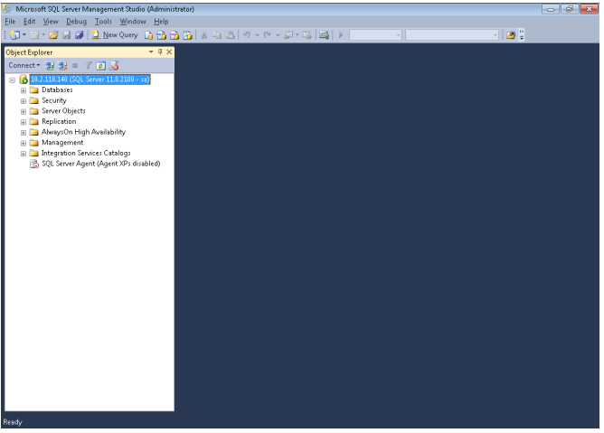
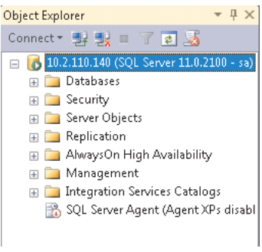
--Details from book
https://docs.microsoft.com/en-us/sql/ssms/tutorials/ssms-configuration?view=sql-server-2017

Slide 50
Comments
Microsoft SQL Server supports two types of commenting styles:
1. Single line comment:
-- (double hyphens) A complete line of code or a part of a code can be marked as a comment, if two hyphens (- -) are placed at the beginning. The remainder of the line becomes a comment.
2. Multiline Comment:
/* … */ (forward slash-asterisk character pairs) For a multiple-line comment, the open-comment character pair (/*) must begin the comment, and the close-comment character pair (*/) must end the comment.
-- this is single line comment
/* this is
multi line
comments*/
Data Types
https://katieandemil.academy/sql-server-2012-data-types
https://www.w3schools.com/sql/sql_datatypes.asp
https://www.youtube.com/watch?v=yCYF3SKd4ko

Slide 51
Transact-SQL
The queries typed in Transact-SQL and saved as .sql files can be executed directly in the SSMS query window.
Transact-SQL is Microsoft's implementation of the standard SQL.
Usually referred to as T-SQL, this language implements a standardized way to communicate to the database.
The Transact-SQL language is an enhancement to SQL, the American National Standards Institute (ANSI) standard relational database language.
SQL Server supports three types of Transact-SQL statements,
Language Statements:
Data Definition language(DDL)
Data Manipulation language(DML)
Data Control Language(DCL)
--Short cut keys to execute queries F5 or Alt+X or Ctrl+E

Slide 52
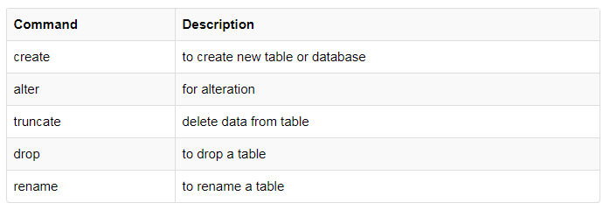
Data Definition language (DDL)
This includes changes to the structure of the table like creation of table, altering table, deleting a table etc.
All DDL commands are auto-committed. That means it saves all the changes permanently in the database.
DDL actions are used to define and manage database objects.
Following are the DDL actions or commands/statements:

Slide 53
CREATE
CREATE DATABASE The CREATE DATABASE statement is used to create a database.
CREATE TABLE
The CREATE TABLE statement is used to create a table in a existing database.
CREATE DATABASE database_name
CREATE TABLE table_name ( column_name1 data_type, column_name2 data_type, column_name3 data_type, .... )

Slide 54
ALTER
3.ALTER TABLE:
The ALTER TABLE statement is used to add, delete, or modify columns in an existing table.
To change the data type of a column in a table:
To delete a column in a table:
To add a column in a table:
ALTER TABLE table_name ALTER COLUMN column_name datatype
ALTER TABLE table name DROP COLUMN column name
ALTER TABLE table_name ADD column_name datatype

Slide 55
DROP
DROP DATABASE:
Drop command is used to remove an Object from a database or used to remove complete database.
//Once a database is dropped, you can check it in the list of databases with the following SQL command: SHOW DATABASES;
When Drop Table command is used, it deletes all rows from that table, then removes the table from the database and removes all references to that table.
Syntax:
DROP TABLE Table_Name Ex: DROP TABLE Department
to drop databse first change into master in use
drop database record

Slide 56
truncate
TRUNCATE TABLE:
Truncate Command is used to delete all the records from a table and frees the space in disc.
Syntax: TRUNCATE TABLE Table_Name Ex: TRUNCATE TABLE Department
REname
TABLE DATA BASE:
sp_rename 'table_name', 'new_table_name';
RENAME DATA BASE:
alter database records
modify name = abc
DUPLICATE TABLE
select * into newtable from students

Slide 57
Difference between Delete and Truncate Command in SQL:
Delete Command | Truncate Command
deletes records from a table based on a condition or deletes all the records if no condition is specified. But it doesn't free the space. | deletes all the records from a table as well as frees up the space.
Difference between Drop and Truncate Command in SQL:
Drop Command | Truncate Command
removes the entire table, all relationships associated with that table, all constraints in that table. We can insert new records in a truncated table. But it is not possible when a table is dropped as it doesn't exist. | removes all rows from a table, but the table structure, all relationships, constraints remain in the Database.

Slide 58
Data Manipulation language (DML)
DML stands for Data manipulation language.
DML are used for managing data in database.
or
DML statements are used to work with the data in tables
These are the following DML statements:
INSERT to insert data into a table
UPDATE to update data in a table
DELETE to delete data from a table
SELECT to select query data in the database

Slide 59
INSERT
Insert statement is used to insert data into a table.
INSERT into table-name values(data1,data2,..)
OR
INSERT INTO TableName [(columnList)] VALUES (dataValueList)
Example
INSERT INTO students (name, id, age) VALUES ('maib', '2014', '10');
SELECT
Select query is used to retrieve data from a tables. It is the most used SQL query.
SELECT column-name1, column-name2,column-nameN from table-name;
SELECT * from table-name;

Slide 60
Select top:
The TOP clause is used to specify the number of records to return.
SELECT TOP 3 * FROM students;
Example
SELECT * FROM students LIMIT 3;
Example
SELECT TOP 3 * FROM students WHERE age=20
SELECT * FROM students
WHERE age=20
LIMIT 3;
Example
SELECT * FROM students WHERE age=20 AND ROWNUM <= 3;
TOP PERCENT
selects the first n% of the records from the table:
SELECT TOP 50 PERCENT * FROM students;

Slide 61
Update
The UPDATE statement is used to modify the existing records in a table.
UPDATE table_name SET column1 = value1, column2 = value2, ...
Delete
The DELETE statement is used to delete existing records(rows) in a table.
DELETE FROM table_name

Slide 62
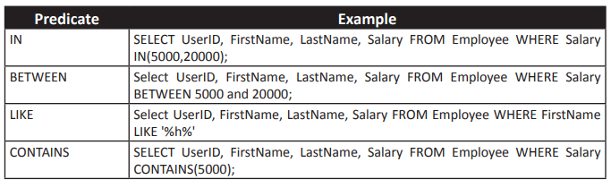
SQL Clauses/Statements
DISTINCT
WHERE
IN Operator
ORDER BY
LIKE operator

Slide 63
DISTINCT
DISTINCT clause is used together with the SELECT keyword, to return a dataset with unique entries.
SQL SELECT DISTINCT is a very useful way to eliminate retrieving duplicate data
SELECT DISTINCT column_name FROM table
SELECT DISTINCT name FROM students
SELECT COUNT(DISTINCT marks) FROM students;
OR
SELECT COUNT(DISTINCT marks) AS distinctMarks FROM students;

Slide 64
WHERE
The WHERE clause is used to filter records.
The WHERE clause is used to extract only those records that fulfill a specified condition.
SELECT * FROM STUDENTS
WHERE age=90;
SELECT * FROM STUDENTS
WHERE name='hamza'
DELETE FROM STUDENTS
WHERE name='usama';
UPDATE STUDENTS SET marks='10' WHERE name='ALTAMASH';

Slide 65
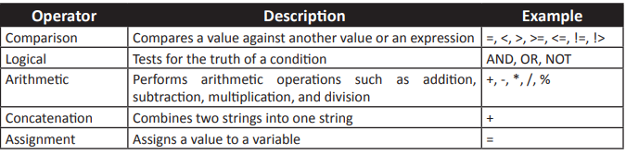
We can use any of the following operators in conjunction with the WHERE clause:
Operator | Description
= | Equal
<> | Not equal
> | Greater than
< | Less than
>= | Greater than or equal
<= | Less than or equal
Logical opertors | AND OR NOT
BETWEEN | Between an inclusive range
LIKE | Search for a pattern
IN | If you know the exact value you want to return for at least one of the columns

Slide 66
Where with logical operators
A WHERE statement can accept multiple conditional statements.
The AND & OR operators are used to filter records based on more than one condition.
AND Syntax
SELECT column1, column2, ... FROM table_name WHERE condition1 AND condition2 AND condition3 ...;
OR Syntax
SELECT column1, column2, ... FROM table_name WHERE condition1 OR condition2 OR condition3 ...;
NOT Syntax
SELECT column1, column2, ... FROM table_name WHERE NOT condition;

Slide 67
Combining operators
SELECT * FROM students WHERE NOT name='shahzaib' AND NOT name='zain';
SELECT * FROM students WHERE subject= 'C' AND (name='hashim' OR name='anas');
logical operator With between
SELECT * FROM students WHERE marks BETWEEN 10 AND 20;
SELECT * FROM students WHERE marks NOT BETWEEN 10 AND 20;
SELECT * FROM students WHERE name NOT BETWEEN 'Altamash' AND 'zain' ORDER BY name;
BETWEEN Dates
SELECT * FROM students WHERE date BETWEEN '1996-07-01' AND '1996-07-31';

Slide 68
IN OPERATOR
The IN operator allows you to specify multiple values in a WHERE clause.
The IN operator is a shorthand for multiple OR conditions.
A scenario where this proves useful would be if we wanted to retrieve customer data for two or more customers. We can use the IN operator to specify a list of customer names, and SQL will retrieve rows reflecting every customer in the list.
SELECT column_name(s) FROM table_name WHERE column_name IN (value1, value2, ...);
OR
SELECT column_name(s) FROM table_name WHERE column_name IN (SELECT STATEMENT);
SELECT * FROM students WHERE (age BETWEEN 10 AND 20) AND NOT id IN (1,2,3);
SELECT * FROM students WHERE (marks BETWEEN 10 AND 20) AND id IN (1,2,3);

Slide 69
Selects all students that are located in “sadar", “nazimabad" and “hydri":
SELECT * FROM students WHERE location IN (' sadar ', ' nazimabad ', ' hydri ');
selects all students that are NOT located in " sadar ", "nazimabad " or " hydri ":
SELECT * FROM students WHERE location NOT IN (' sadar ', ' nazimabad ', ' hydri ');
selects all students that are from the same location as the aptech(another table):
SELECT * FROM students WHERE students IN (SELECT students FROM aptech);

Slide 70
ORDER BY
ORDER BY is the SQL command used to sort rows as they are returned from a SELECT query.
The ORDER BY keyword sort the records in ascending order by default.
If you want to sort the records in a descending order, you can use the DESC keyword.
Syntax
SELECT column_name(s) FROM table_name ORDER BY column_name(s) ASC|DESC
Example
SELECT * FROM students
ORDER BY name DESC;

Slide 71
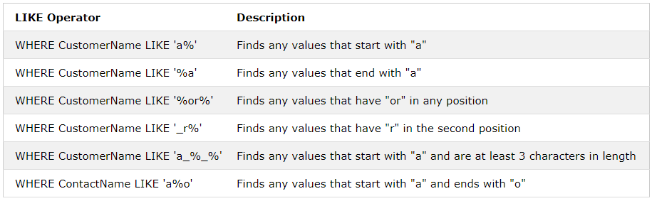
LIKE Operator
The LIKE operator is used in a WHERE clause to search for a specified pattern in a column.
1. % The percent sign represents zero, one, or multiple characters
2. _The underscore represents a single character
SELECT column1, column2, ... FROM table_name WHERE columnN LIKE pattern;
SELECT * FROM students
WHERE name LIKE '%a';

Slide 72
Wildcard Characters
A wildcard character is used to substitute any other character(s) in a string.
It is used with the LIKE operator.
Wildcard | Description
% | A substitute for zero or more characters
_ | A substitute for exactly one character
[charlist] | Any single character in charlist
[^charlist]or [!charlist] | Any single character not in charlist

Slide 73
CONSTRAINTS
SQL constraints are used to specify rules for data in a table.
Constraints can be specified when the table is created with the CREATE TABLE statement, or after the table is created with the ALTER TABLE statement.
Syntax
CREATE TABLE table_name ( column1 datatype constraint, column2 datatype constraint, column3 datatype constraint, .... );
The following constraints are commonly used in SQL:
NOT NULL - Ensures that a column cannot have a NULL value
UNIQUE - Ensures that all values in a column are different
PRIMARY KEY - A combination of a NOT NULL and UNIQUE. Uniquely identifies each row in a table
FOREIGN KEY - Uniquely identifies a row/record in another table
CHECK - Ensures that all values in a column satisfies a specific condition
DEFAULT - Sets a default value for a column when no value is specified
INDEX - Used to create and retrieve data from the database very quickly

Slide 74
NOT NULL Constraint
By default, a column can hold NULL values.
The NOT NULL constraint enforces a column to NOT accept NULL values.
This enforces a field to always contain a value, which means that you cannot insert a new record, or update a record without adding a value to this field.
CREATE TABLE students ( ID int NOT NULL, name varchar(255) NOT NULL, Age int );
How to Test for NULL Values?
It is not possible to test for NULL values with comparison operators, such as =, <, or <>.
We will have to use the IS NULL and IS NOT NULL operators instead.
IS NULL Syntax
SELECT column_names FROM table_name WHERE column_name IS NULL;
Example:
SELECT name, age FROM students WHERE location IS NULL;
IS NOT NULL Syntax
SELECT column_names FROM table_name WHERE column_name IS NOT NULL;
Example:
SELECT * FROM students WHERE location IS NOT NULL;

Slide 75
UNIQUE Constraint
The UNIQUE constraint ensures that all values in a column are different.
Both the UNIQUE and PRIMARY KEY constraints provide a guarantee for uniqueness for a column or set of columns.
A PRIMARY KEY constraint automatically has a UNIQUE constraint.
However, you can have many UNIQUE constraints per table, but only one PRIMARY KEY constraint per table.
CREATE TABLE Persons ( ID int NOT NULL UNIQUE, LastName varchar(255) NOT NULL, FirstName varchar(255), Age int );
To define a UNIQUE constraint on multiple columns
CREATE TABLE students ( ID int NOT NULL, name varchar(255) NOT NULL, Age int, CONSTRAINT students UNIQUE (ID,name) );

Slide 76
PRIMARY KEY Constraint
The PRIMARY KEY constraint uniquely identifies each record in a database table.
Primary keys must contain UNIQUE values, and cannot contain NULL values.
A table can have only one primary key, which may consist of single or multiple fields.
CREATE TABLE students( ID int NOT NULL, name varchar(255) NOT NULL, Age int, PRIMARY KEY (ID));
FOREIGN KEY Constraint
A FOREIGN KEY is a key used to link two tables together.
A FOREIGN KEY is a field (or collection of fields) in one table that refers to the PRIMARY KEY in another table.
The table containing the foreign key is called the child table, and the table containing the candidate key is called the referenced or parent table.
CREATE TABLE aptech ( brandID int NOT NULL, location varchar(255) NOT NULL, studentID int, PRIMARY KEY (branchID), FOREIGN KEY (studentID) REFERENCES students(studentID));
Notes:
A primary key enforces the consistency of uniqueness of values over one or more columns. If an ID column has a primary key then it is impossible to have two rows with the same ID value. Without that primary key, many rows could have the same ID value and you wouldn't be able to distinguish between them based on the ID value alone.
A foreign key enforces the consistency of data that points elsewhere. It ensures that the data which is pointed to actually exists. In a typical parent-child relationship, a foreign key ensures that every child always points at a parent and that the parent actually exists. Without the foreign key you could have "orphaned" children that point at a parent that doesn't exist.

Slide 77
CHECK Constraint
The CHECK constraint is used to limit the value range that can be placed in a column.
If you define a CHECK constraint on a single column it allows only certain values for this column.
If you define a CHECK constraint on a table it can limit the values in certain columns based on values in other columns in the row.
CREATE TABLE students ( ID int NOT NULL, name varchar(255) NOT NULL, Age int, CHECK (Age>=18));
DEFAULT Constraint
The DEFAULT constraint is used to provide a default value for a column.
The default value will be added to all new records IF no other value is specified.
CREATE TABLE students ( ID int NOT NULL, name varchar(255) NOT NULL, Age int, location varchar(255) DEFAULT ‘nazimabad');
CREATE INDEX Statement
The CREATE INDEX statement is used to create indexes in tables.
Indexes are used to retrieve data from the database very fast. The users cannot see the indexes, they are just used to speed up searches/queries.
Syntax
CREATE INDEX index_name ON table_name (column1, column2, ...);

Slide 78
INDEX
Explanation:
Every organization has its database and each and every day with the increase in the data volume these organizations has to deal with the problems relating to data retrieval and accessing of data.
There is need of system which will results into increase in the data access speed.
An index (in simple words it like index of any book eg. While searching a word in Book we use index back of book to find the occurrence of that word and its relevant page numbers), which makes it easier for us to retrieval and presentation of the data.
An Index is a system which provides faster access to rows and for enforcing constraints.
Indexes are special lookup tables that the database search engine can use to speed up data retrieval.
An index is a pointer to data in a table.
An index in a database is very similar to an index in the back of a book.
An index helps to speed up SELECT queries and WHERE clauses, but it slows down data input, with the UPDATE and the INSERT statements. Indexes can be created or dropped with no effect on the data.
Updating a table with indexes takes more time than updating a table without (because the indexes also need an update). So, only create indexes on columns that will be frequently searched against
If we don't create any indexes then the SQL engine searches every row in table (also called as table scan). As the table data grows to thousand, millions of rows and further then searching without indexing becomes much slower and becomes expensive.

Slide 79
Types of Indexes
UNIQUE INDEX
Clustered INDEX
Non Clustered Index
UNIQUE INDEX:
A unique index does not allow any duplicate values in the index field of a table.
It ensures that every row in the table is unique.
While designing a unique index, consider the following guidelines:
A unique index cannot be created if duplicate key values exists in the table.
Non-key columns can be included in a unique non-clustered index.
Note: that unique indexes cannot be created on a single column if the column contains NULL in more than one row. Similarly indexes cannot be created on multiple columns if the combination of the columns contains NULL in some rows. The NULL values are treated as duplicate values.

Slide 80
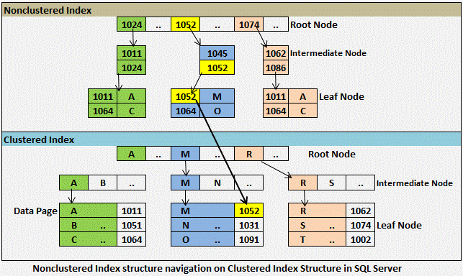
Clustered Index
A clustered index stores data rows in the table based on their key values. Each table can have only one clustered index as the key values in the data rows are unique and the index is built on the unique key column. When a table has a clustered index, it is known as a clustered table.
A table can have only one clustered index.
PRIMARY KEY constraints create clustered indexes automatically if no clustered index already exists on the table.
A clustered index rearranges the data in a sequential manner.
Example: Telephone directory
OR
Clustered indexes can be created in SQL Server databases. In such cases the logical order of the index key values will be the same as the physical order of rows in the table. A table can have only one clustered index.
Non-Clustered indexes have structures that are different from the data rows. A non clustered index key value is used to point to data rows that contain the key value. This value is known as row locator.
Typically created on non-primary key columns used in JOIN, WHERE, and ORDER BY clause.
Notes:
Indexes can be deleted. Usually an index is considered for deletion when the performance of the INSERT,UPDATE and DELETE operations are hindered by the Index.

Slide 81
Relevant Information:
Data Pages
The actual data in your table is stored in Pages.
SQL server stores the row of a table in data pages.
A data pages is the smallest unit of data storage.
Each Page can contain 8KB of information.
Extents
A group of 8 adjacent data pages is called an extent.
extents are the basic units used to manages space in a database.
Extents are used to efficiently manages the data pages.
The size of an extents is 64 KB.
Two type of extents
Uniform extents
Extents owned by single object( single table)
Mixed extents
Extents shared by multiple objects(multiple tables)

Slide 82
Identity Property
AUTO INCREMENT Field
Auto-increment allows a unique number to be generated automatically when a new record is inserted into a table.
Often this is the primary key field that we would like to be created automatically every time a new record is inserted
create table learner2
(
id int identity(1,5),
name varchar(50) ,
roll int
)
insert into learner2 values ('zain' , 62)
select * from learner2

Slide 83
Aliases
aliases are used to give a table, or a column in a table, a temporary name.
Aliases are often used to make column names more readable.
An alias only exists for the duration of the query.
Alias Table Syntax
SELECT age,marksFROM students AS abc
Alias Column Syntax
SELECT column_name AS alias_name FROM table_name;
Example
SELECT age AS b03age, name AS b03nameFROM students;

Slide 84
statement creates an alias named "Address" that combine four columns (Address, PostalCode, City and Country):
SELECT CONCAT(name,', ',age) AS info,marks
FROM students;
Alias for Tables Example
We use the “students" and “aptecg" tables, and give them the table aliases of “s" and “a" respectively (Here we use aliases to make the SQL shorter)
SELECT p.name, s.age, s.marks FROM students AS s, pupil AS p WHERE s.name=p.name;
Or
SELECT * FROM students AS s, pupil AS pWHERE s.name=p.name;
OR
The following SQL statement is the same as above, but without aliases:
SELECT *FROM students, pupil;
OR
SELECT students.name, students.age, pupil.nameFROM students, pupilWHERE students.name=pupil.name;

Slide 85
SQL Joins
A JOIN clause is used to combine rows from two or more tables, based on a related column between them.
Or
The JOIN keyword is used in a SQL statement to query data from two or more tables based on a relationship between certain columns in these tables.
To join data from two tables you write
the names of two tables in the FROM clause
along with JOIN keyword and
an ON phrase that specifies the join condition
Join conditions
The join condition indicates how two tables should be compared.
Inner Join
Outer Join
Full Outer Join
Left Outer Join
Right Outer Join
Self Join
/*In most cases they are compares on the base on the relationship of primary key of the first table and foreign key of the second table. */

Slide 86
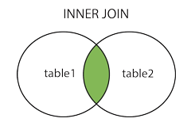
Inner Join
The INNER JOIN keyword selects records that have matching values in both tables.
OR
The INNER JOIN is formed when records from two tables are combined only if the rows from both the tables are matched based on a common column.
SELECT column_name(s) FROM table1 INNER JOIN table2 ON table1.column_name = table2.column_name;
SELECT * FROM STUDENTS INNER JOIN pupil ON students.name=pupil.name

Slide 87

LEFT Join
The LEFT JOIN keyword returns all records from the left table (table1), and the matched records from the right table (table2). The result is NULL from the right side, if there is no match.
SELECT column_name(s) FROM table_name1 LEFT JOIN table_name2 ON table_name1.column_name=table_name2.column_name
SELECT *FROM studentsLEFT JOIN pupil ON students.name=pupil.name

Slide 88

Right Join
The RIGHT JOIN keyword returns all records from the right table (table2), and the matched records from the left table (table1). The result is NULL from the left side, when there is no match.
SELECT column_name(s) FROM table_name1 RIGHT JOIN table_name2 ON table_name1.column_name=table_name2.column_name
SELECT * FROM students RIGHT JOIN pupil ON students.name=pupil.name

Slide 89

FULL Join
The FULL JOIN keyword return rows when there is a match in one of the tables.
OR
The FULL OUTER JOIN keyword return all records when there is a match in either left (table1) or right (table2) table records.
SELECT column_name(s) FROM table_name1 FULL JOIN table_name2 ON table_name1.column_name=table_name2.column_name
SELECT *FROM students FULL JOIN pupil ON students.name=pupil.name

Slide 90
SELF Join
A self JOIN is a regular join, but the table is joined with itself.
OR
A SELF JOIN is used to find records in a table that are related to other records in the same table.
.
SELECT column_name(s) FROM table_name1 INNER JOIN table_name2 ON table_name1.column_name=table_name2.column_name
SELECT * FROM STUDENTS T1, STUDENTS T2 where t1.age=t2.marks

Slide 91

SQL FUNCTIONS
SQL has many built-in functions for performing calculations on data.
Aggregate functions.
String functions
Math/numeric functions
Date functions
For more functions visit:
https://www.w3schools.com/sql/sql_ref_sqlserver.asp

Slide 92
GROUP BY
The GROUP BY clause is used to organize output rows into groups.
Group by clause can be used with different clauses.:
Group by with where
Group by with null
Group by with all
Group by with having
GROUP BY WITH WHERE
The where clause can be used with group by clause to restrict the row for grouping.
The rows that satisfy the search condition are considered for grouping
Select name,avg(age) as averageAge from pupil where name like '%a%' group by name
GROUP BY WITH NULL
If the grouping column contain a null value, that row become a separate group in the result set
select location,count(name) from pupil where location is NULL group by location

Slide 93
GROUP BY ALL
ALL is significant only when the SELECT has a WHERE clause. When ALL is used. It includes all the group by clause produces. It even includes those groups which do not meet the search conditions.
Select name,sum(age) from pupil where name like 'a%' or name like 'c% 'group by all name
GROUP BY HAVING
The difference between the having and where clause in sql
is that the where clause can not be used with aggregates,
but the having clause can.
select name, SUM(age) from pupil group by name having SUM(age) < 3

Slide 94
SUMMARIZING DATA
Group by clause also uses operator like
Rollup
Cube
Differences between CUBE and ROLLUP:
ROLLUP | CUBE
ROLLUP generates a result set that shows aggregates for a hierarchy of values in the selected columns. | CUBE generates a result set that shows aggregates for all combinations of values in the selected columns
Rollup
The ROLLUP extension produces group subtotals from right to left and a grand total.
CUBE
In addition to the subtotals generated by the ROLLUP extension, the CUBE extension will generate subtotals for all combinations of the dimensions specified.

Slide 95

Subquery
A Subquery or Inner query or a Nested query is a query within another SQL query and embedded within the WHERE clause.
4
The basic concept is to pass a single value or many
values from the subquery to the next query and so on.
When reading or writing SQL subqueries, you should start from the bottom upwards, working out which data is to be passed to the next query up.
3
2
1
Subquery Syntax
SELECT select_list
FROM table
WHERE expr operator
(SELECT select_list FROM table);

Slide 96

Using a Subquery to Solve a Problem
SELECT name, marks FROM students
WHERE marks >
(SELECT marks FROM students WHERE name='Sameer');
There are a few rules that subqueries must follow −
Subqueries must be enclosed within parentheses.
A subquery can have only one column in the SELECT clause, unless multiple columns are in the main query for the subquery to compare its selected columns.
An ORDER BY command cannot be used in a subquery, although the main query can use an ORDER BY. The GROUP BY command can be used to perform the same function as the ORDER BY in a subquery.
Subqueries that return more than one row can only be used with multiple value operators such as the IN operator.
The BETWEEN operator cannot be used with a subquery. However, the BETWEEN operator can be used within the subquery.

Slide 97
Types of Subqueries
Single-row subquery
Multiple-row subquery
Multiple-Row Subqueries
Return more than one row
Use multiple-row comparison operators
Operator | Meaning
IN | Equal to any member in the list
ANY | Must be preceded by =, !=, >, <, <=, >=. Compares a value to each value in a list or returned by a query. Evaluates to FALSE if the query returns no rows.
ALL | Must be preceded by =, !=, >, <, <=, >=. Compares a value to every value in a list or returned by a query. Evaluates to TRUE if the query returns no rows.

Slide 98

VIEWS
A view is an "Virtual Table".
It can have multiple columns and rows from the one or more table.
Normally view cannot store the data permanently in the table.
Views display only those data which are mentioned in the query.
A view contains rows and columns, just like a real table. The fields in a view are fields from one or more real tables in the database.
A view can also be called as a saved SELECT query or you can say A view consists of a SELECT statement.
A view can have a maximum of 1024 columns.

Slide 99
USE Of VIEWS
Views are used as Security Mechanism of Database.
A view can be useful when there are multiple users with different levels of access, who all need to see portions of the data in the database.
Views can do the following:
Restrict access to specific rows in a table
Restrict access to specific columns in a table
Join columns from multiple tables and present them as though they are part of a single table
Present aggregate information (such as the results of the COUNT function).

Slide 100
Creating a View
General syntax for creating a view:
CREATE VIEW [View_Name]
AS
[SELECT Statement]
CREATE VIEW abc
As name,marks FROM students
Running a View
This is as similar as select statement of a table.
SELECT * FROM abc
Drop a View
General syntax:
DROP VIEW viewname;
Example:
DROP VIEW abc;
Notes:
When a view is dropped, it has no effect on the underlying tables.
Dropping a view removes its definition and all the permissions assigned to it.
However, dropping a table that references a view does not drop the view automatically.
You must drop it explicitly.

Slide 101
Alter a View
General syntax:
ALTER VIEW viewname
AS
SELECT…;
Example:
ALTER VIEW abc
AS
SELECT * FROM students;
Display VIEW definition
There are 3 methods to see the view definition:
Method 1: Sp_helptext viewname;
Method 2: select definition from sys.sql_modules
where object_id=object_id(‘viewname’);
Method 3: select object_definition(object_id('vv'));
Notes:
The sys.sql_modules is a system view. It is used to display view definition.
Object_definition() is built-in function that returns the view definition.
Object_id() is a system function that returns the ID of view.

Slide 102
TYPES OF VIEWS
There are two types of views.
Normal or Standard view
Partitioned view
Normal /Standard views:
This view is most frequently used by the developers.
When we create the view the schema will be stored as object in the database.
When we retrieve the content from this virtual table, it will execute the schema and the stored data from the parent table.
These include focusing on specific data and simplifying data manipulation.
CREATE VIEW abc AS SELECT * FROM students;
SELECT * FROM abc;
INSERT INTO abc VALUES(‘hamza’,20,20);
DELETE FROM abc WHERE EmpID = 1;
Here you can do the DML operations in the view when you have only one table.

Slide 103
Partitioned Views:
The partitioned view and its execution is like normal view.
It will work across the database and across the server.
There are two types of Partitioned views.
Local Partitioned View
Global Partitioned View
Local Partitioned View:
The local partitioned view can be created within same server but different database.
The view schema definition will be stored in the executed database.

Slide 104
Global Partitioned View
The global Partitioned view will work across the server.
The view can be created to join the table across the server.
The accessing format will be like this.
When we execute the view if it is not linked with the current server then it will ask us to link the external server
[Server Name]. Database Name. Table Name
The following system stored procedure will be used to link the server.
The following system catalog table is used to see the list of linked servers
sp_addlinkedserver 'Server name'
SELECT * FROM SYS.SERVERS

Slide 105

View Creation Option
There are two different option for creating a view.
Schema Binding Option
Encryption
Schema BindSchema Binding Option :
If we Creates a view with the SCHEMABINDING option it will locks the tables being referred by the view and restrict any kinds of changes that may change the table schema ( No Alter Command) .
While creating schema binding view, we can't mention "Select * from tablename" with the query. We have to mention all the column name for reference
CREATE VIEW DemoSampleView
With SCHEMABINDING
As
SELECT EmpID, EmpName, FROM DBO.EmpInfo;
While specifying the Database name we have use Dbo.[DbName] .
This will prevent any of the underlying tables from being altered without the view being dropped.

Slide 106
Encryption
This option encrypts the definition.
This option encrypts the definition of the view.
Users will not be able to see the definition of the View after it is created.
This is the main adavatages of view where we can make it secure.
Note: Once view is encrypted, there is no way to decrypt it again.
CREATE VIEW DemoView
With ENCRYPTION
Select ename,edesig from dbo.EmpInfo

Slide 107
STORED PROCEDURES
INTRODUCTION TO STORED PROCEDURES
A stored procedure is nothing more than prepared SQL code that you save so you can reuse the code over and over again.
So if you think about a query that you write over and over again, instead of having to write that query each time you would save it as a stored procedure and then just call the stored procedure to execute the SQL code that you saved as part of the stored procedure.
In addition to running the same SQL code over and over again you also have the ability to pass parameters to the stored procedure, so depending on what the need is the stored procedure can act accordingly based on the parameter values that were passed.
Types of Stored Procedure
Extended stored procedures
System stored procedures
User defined stored procedures

Slide 108
Types Of Stored Procedures
Extended Stored procedures:
Extended stored procedures help SQL in interecting with operating system.These are carried out in DLL(Dynamic Link Library).It calls at the runtime.
System Stored Procedure
System stored procedure are commonly used for interacting with system tables.
They are prefixed with “sp_”
Catalog Stored Procedure
Database Stored Procedure
Database Engine Stored Procedure
Security Stored Procedure
Full-text Stored Procedure
User Defined:
User defined stored procedures are also known as custom stored stored procedures. These procedures are used for reusing Transact-SQL statements for performing repetitive task.

Slide 109
Input Variables
There are many reasons for wanting to pass data to a stored procedure, especially if your stored procedure is being called by a dynamic web page or other application.
You may want to use a SELECT statement to pull information into the application for dynamic display. In this case, you would pass selection criteria to the stored procedure (for use in a WHERE clause).
If you are inserting new records, you will need to get the data from somewhere. Updating existing records also involves simply getting the data. In both INSERT and UPDATE statements, it is necessary to pass data to the stored procedure. For INSERT, UPDATE, and SELECT statements (to name a few), you can pass the data to your stored procedure using variables.

Slide 110
TRY…….CATCH Construct
Each try catch construct must be inside a stored procedure.
A TRY block must be immediately followed by a CATCH block.
To handle an error that occurs within a given CATCH block, write a TRY…CATCH block within the specified CATCH block.
Errors that have the 10 or below severity level are not handled by try…catch blocks. These errors are considered as warning or informational messages.
Errors that have severity of 20 or higher are not handled by try…catch blocks. Database engine close the connection will not be handled by the try..catch block.
ERROR Function
Error_line()
Error_number()
Error_message()
Error_procedure()
Error_severity()
Error_state()

Slide 111
EXAMPLE
Create procedure delete_employee
@empid bigint
As
Set @empid=‘E001’
Delete from employee where emp_id=@empid
Begin try
Execute delete_employee
End try
Begin catch
Select error_procedure() as ErrorProcedure
End catch
Sp_addmessage stored procedure
Execute sp_addmessage @msgnum=50001, @severity=10,
@msgtext=‘This is a customized error’,
@lang=‘us_english’
Raiserror(50001,10,1)

Slide 112
Transactions
SQL Transaction gives you the “power to return back to a safe state if some error happens in the middle of your SQL Code”.
A transaction is a single unit of work. If a transaction is successful, all of the data modifications made during the transaction are committed and become a permanent part of the database. If a transaction encounters errors and must be canceled or rolled back, then all of the data modifications are erased.
Transaction Control
The following commands are used to control transactions.
COMMIT − to save the changes.
The COMMIT command is the transactional command used to save changes invoked by a transaction to the database.
ROLLBACK − to roll back the changes.
The ROLLBACK command is the transactional command used to undo transactions that have not already been saved to the database. This command can only be used to undo transactions since the last COMMIT or ROLLBACK command was issued.

Slide 113
Triggers
Triggers in SQL Server 2012 are a special kind of stored procedure that fires automatically; they are invoked or executed when an event occurs in the database server.
We can create Data Manipulation Language (DML) triggers and Data Definition Language (DDL) triggers in SQL Server 2012.
When the user wants to modify data using a DML event then the DML trigger is executed. In other words, a DML trigger is used for INSERT, DELETE and UPDATE statements of a table or view.
When the user attempts to perform an operation using DDL then the DDL trigger is executed. In other words, a DDL trigger is executed for CREATE, ALTER and DROP statements of a table or view.
There are two types of triggers AFTER TRIGGER and INSTEAD OF TRIGGER

Slide 114

DATA CONTROL LANGUAGE (DCL)
DCL is used to control permission on database objects.
DCL statements are used to take care of the security and authorization.
Types of DCL statements are as follows
Grant statement
Revoke statement
Deny statement

Slide 115
Grant statement
Grant privilege (rights which are to be allocated ) is used when database is to be shared with other users, with certain types of rights granted to the users.
Permissions are controlled by using the grant and revoke statements and deny statement.
Revoke statement removes a previously granted or denied permission from a user in the current database
Revoke
{all | statement}
On table_name
From security_acccount
Example :
Revoke select on employee from john
The deny statement creates an entry in the security system that denies a permission from a security account in the current database and prevents the security account from inheriting the permission through its group or role membership.
Deny {all | statement}
On table_name
To security_account
Example:
Deny select on employee to john

